Slide 1


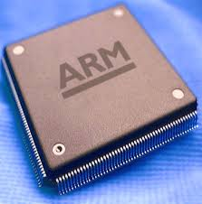
Microprocessor & Computer Architecture UE17CS253
UNIT-3
Session –5 & 6
Cache Performance

Slide 2



Cache Performance
The Processor Performance Equation

Slide 3
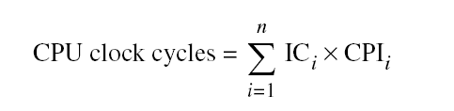
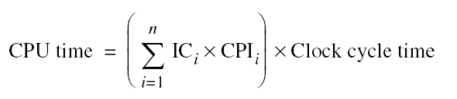
Cache Performance
Different instruction types having different CPIs
One method to evaluate cache performance is to expand processor execution time i.e., [Instruction Count ]- IC
Add memory stall cycles - the number of cycles during which the processor is waiting for a memory access.
CPU Execution = (CPU clock cycles + Memory stall cycles) x Clock cycle time
time

Slide 4
Cache Performance
Equation assumes that CPU clock cycles include
The time to handle a cache hit.
The processor stalled during the cache miss.
The number of memory stall cycles depends on
The number of misses
The cost per miss
This is called Miss penalty.
Memory stall cycles = Number of misses x Miss penalty.
= IC x Misses x Miss penalty.
Instructions
= IC x Memory Accesses x Miss Rate x Miss penalty
where, Instructions
Miss rate = Cache access that result in a miss.
=> ( # of access that miss )
( # of access)
Note: miss rates and miss penalties are often different for read & writes.

Slide 5
Cache Performance
Memory stall cycles can be defined in terms
Number of memory accesses per instruction.
Miss penalty ( in clock cycles for reads & writes)
Miss rate ( for reads & writes)
That is,
Memory stall = IC x Reads per instruction x Reads miss rate x Reads miss penalty +
clock cycles IC x writes per instruction x writes miss rate x writes miss penalty
Normally, simplifying the complete formula,
Combining reads & writes.
Finding the average miss rates and miss penalty for reads & writes.
= IC x Memory Accesses x Miss Rate x Miss penalty
Instructions
Note:
Miss rate is not the only most important measures of the cache design.

Slide 6
Cache Performance -Example 1
Assume we have a computer where the cycles per instruction (CPI ) is 1.0 when all memory accesses hit in the cache.
The only data accesses are loads and stores, and these total 50% of the instructions. If the miss penalty is 25 clock cycles and the miss rate is 2%, how much faster would the computer be if all instructions were cache hits?
Ans: First compute the performance for the computer that always hits:
CPU execution time = ( CPU clock cycles + Memory stall cycles) × Clock cycle
= ( IC × CPI + 0) × Clock cycle
= IC × 1.0 × Clock cycle
Now for the computer with the real cache, first we compute memory stall cycles:
Memory stall cycles = IC × Memory accesses x Miss rate × Miss penalty
Instruction
= IC × (1 + 0.5) × 0.02 × 25
= IC × 0.75
where the middle term (1 + 0.5) represents one instruction access and 0.5 data
accesses per instruction. The total performance is thus
CPU execution time cache = (IC × 1.0 + IC × 0.75) × Clock cycle
= 1.75 × IC × Clock cycle

Slide 7
Cache Performance -Example 1
The performance ratio is the inverse of the execution times:
CPU execution time _{cache} = 1.75 × IC × Clock cycle = 1.75
CPU execution time 1.0 × IC × Clock cycle
Hence, The computer with no cache misses is 1.75 times faster.

Slide 8
Cache Performance
CPU performance is measured by
Instruction Count
Miss Rate
Both independent of hardware
A better measure of memory hierarchy performance is
- Average memory access time.
Average memory access time = Hit time + Miss rate x Miss penalty.
where Hit time – Time to hit in the cache.
The components of a average access time can be measured either as
Absolute time on a hit.
Say, 0.25 to 1.0 ns.
Number of clock cycles that the processor waits for the memory
Such as 150 to 200 clock cycles.
Note:
Average memory access time is still an indirect measure of performance.,
Although, better measure than miss rate.
This formula can help to decide between spilt cache and a unified cache.

Slide 9
Cache Performance- Average memory access time
CPU time = [ CPU execution clock cycles + Memory stall clock
cycles ] x Clock cycle time.
The equation has a question:
Clock cycles for a cache hit should be considered part of
CPU execution clock cycles? or
Memory stall clock cycles?
Most widely accepted is to include in CPU execution clock cycles.

Slide 10
Cache Performance – Example 2
Assume that the cache miss penalty is 200 clock cycles, and all instructions normally take 1.0 clock cycles (ignoring memory stalls). Assume that the average miss rate is 2%, there is an average of 1.5 memory references per instruction, and the average number of cache misses per 1000 instructions is 30. What is the impact on performance when behavior of the cache is included? Calculate the impact using both misses per instruction and miss rate.
Ans: CPU_{time} = IC x [ CPI _{execution} + Memory stall clock cycles ] x Clock cycle time
instruction
The performance, including cache misses, is
CPU time _{with Cache} = IC x [ 1.0 + ( 30/1000 x 200) x Clock cycle time
= IC x 7.00 x Clock cycle time.
The clock cycle time and instruction count are the same, with or without a cache.
Thus CPU time increases sevenfold, with CPI from 1.00 for a perfect cache to 7.00 with cache that can miss.

Slide 11
Cache Optimizations
The equation,
Average memory access time = Hit time + Miss rate x Miss penalty.
Gives a frame work to present cache optimizations for improving cache performance:
Hence, six basic cache optimizations can be organized into three categories.
Reducing the miss rate
Larger block size, Larger cache size, and higher associativity.
Reducing the miss penalty
Multilevel caches and giving reads priority over the writes.
Reducing the time to hit in the cache
Avoiding address translation when indexing the cache.

Slide 12
Cache Optimizations
The classical approach to improve cache behavior is to reduce miss rates.
Three categories misses are:
Compulsory :
The very first access to block cannot be in the cache. So, the block must be brought into the cache.
These are called cold-start misses or first reference misses.
Capacity:
If the cache cannot contain all the blocks needed during execution of a program, capacity misses [ in addition to compulsory misses] will occur because of blocks being discarded and later retrieved.
Conflict:
If the block placement strategy is set associative or direct mapped, conflict misses [in addition to compulsory and capacity misses ] will occur because a block may be discarded and later retrieved if too many blocks map to its set. These misses are also called collision misses.
The idea is that hits in a fully associative cache that become misses in an n-way set associative cache, due to more than n requests on some popular sets.
NOTE: Further adds a 4th C , for coherence misses due to flushes to keep multiple caches coherent in a multiprocessor environment.

Slide 13
Cache Optimizations
Compulsory Misses :
Those that occur in an infinite cache.
Capacity Misses:
Those that occur in a fully associative cache.
Conflict Misses:
Those that occur going from fully associative to eight-way associative, four–way associative , and so on…
To show the benefit of associativity, conflict misses are divided into misses caused by each decrease in associativity.
Here are the four divisions of conflict misses and how they are calculated:
■ Eight-way—Conflict misses due to going from fully associative (no conflicts)
to eight-way associative
■ Four-way—Conflict misses due to going from eight-way associative to four way
associative
■ Two-way—Conflict misses due to going from four-way associative to two way
associative
■ One-way—Conflict misses due to going from two-way associative to one way
associative (direct mapped)

Slide 14
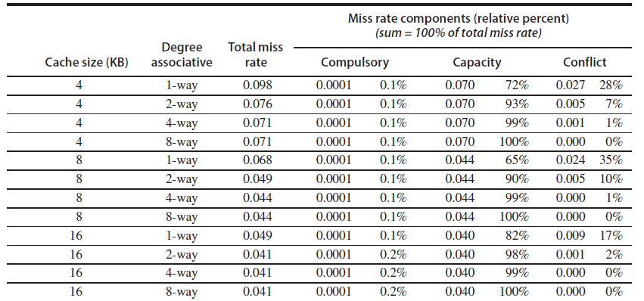
Cache Optimizations
Conceptually, conflicts are the easiest:
Fully associative placement avoids all conflict misses,
Expensive in hardware and
May slow down the processor clock rate leads to lower overall performance.

Slide 15
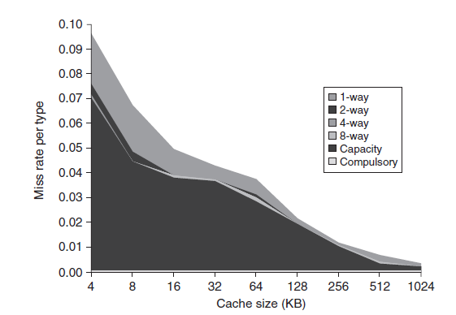
Cache Optimizations

Slide 16
Six Basic Cache Optimizations
First Optimization : Larger Block Size to Reduce Miss Rate.
Second Optimization : Larger Caches to Reduce Miss Rate .
Third Optimization : Higher Associativity to Reduce Miss Rate.
Fourth Optimization : Multilevel Caches to Reduce Miss Penalty.
Fifth Optimization : Giving Priority to Read Misses over Writes to Reduce Miss Penalty.
Sixth Optimization : Avoiding Address Translation during Indexing of the Cache to Reduce Hit Time.

Slide 17
Q & A
On
Cache Optimizations

